Slide 1
AWB收敛速率对比
邹卓良
2024.02.21

Slide 2
结论：AWB算法在45帧下、在相对比较剧烈的色温变化中（2000-3000K）并未有明显的因帧数不够导致的卡顿和过渡不均匀现象。因为AWB没有固定的target，而是处于时刻变化中，AWB 的收敛过程主要可以由软件算法控制。45帧率下，通过软件算法调参可达到与90fps非常解决的平滑过渡表现。

Slide 3
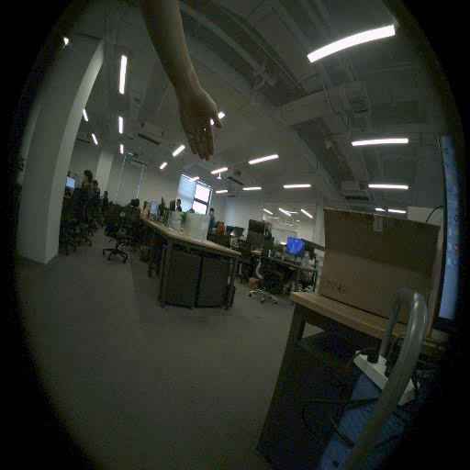
isp:90 fps AWB:90fps
isp:90 fps AWB:60fps
收敛所需帧数一致

Slide 4
isp:90 fps AWB:90fps
isp:90 fps AWB:45fps
收敛所需帧数一致

Slide 5
isp:90 fps AWB:90fps
isp:90 fps AWB:60fps
收敛所需帧数一致 ，收敛速度设置为极慢，可看到差异。

Slide 6
isp:90 fps AWB:90fps
isp:90 fps AWB:60fps
收敛所需时间一致

Slide 7
isp:90 fps AWB:90fps
isp:90 fps AWB:45fps
收敛所需时间一致

Slide 8
帧数 | AWB 90fps RGain | AWB 45fps RGain | AWB 90fps BGain | AWB 45fps BGain
1-20 | 0.581564033265433 0.5824441981804169 0.5839474835417899 0.5857584230012141 0.5885982299237609 0.5918760494062046 0.5962227370818864 0.6004086678044068 0.605090086073156 0.6097993176790312 0.6145141304155853 0.6188703246842556 0.623947370672516 0.6284764387271147 0.6325600478752965 0.6359955124811794 0.6385245320875452 0.6397954754289547 0.6404598996122848 0.6404999380010341 | 0.5811628230837524 0.5819412801759182 0.5827742846036673 0.5846692662179744 0.5863679789348293 0.5900646742668889 0.5931246340686516 0.5979808457247955 0.6017750801943815 0.6076254060059489 0.6114777492023115 0.617120671344901 0.6209673416331091 0.6263835934868707 0.629743753998651 0.6340416881447255 0.6365490433445731 0.6390503623860351 0.6399820998619437 0.6407455868870944 | 0.43530720052945693 0.43487995402458307 0.43408526419862936 0.4334697578125315 0.43207602926166333 0.4307730246168891 0.42853073861283264 0.42689407499526694 0.42465360099121446 0.42246307221783824 0.4204064519719181 0.41882388482208077 0.41668050492429565 0.41495650146799584 0.4136171930004317 0.41234866702975886 0.411534033160462 0.4113380971876907 0.41119350391246423 0.4112379909326861 | 0.4355323204214452 0.43519184255594345 0.4348494890570385 0.4342536282257665 0.43370332387687804 0.43206878514591784 0.43073104343147894 0.4286420434868644 0.42680655087461694 0.42377259789926097 0.42182287930597673 0.4193357678665216 0.41759991465724217 0.41547092980913725 0.41454040532414105 0.4131649777008324 0.4123269429236946 0.4117234802624177 0.4115131492399661 0.41114885227762005
收敛所需时间一致

Slide 9
isp:90 fps AWB:90fps
isp:45 fps AWB:45fps
收敛所需时间一致

